Slide 1
James Mitchell
Late People
Quick Start Smart City AI
Design Proposal
AI-Powered Power Distribution for a Resilient City
Team Members: Tag Tribble · Milana Datilma
Presented to James Mitchell · 05/22/26 · Boone High School

Slide 2
Part 1: City Power Profile
SLIDE 2 OF 9
CRITICAL
FLEXIBLE
NON-CRITICAL
Hospital, Clinic, Fire Station, Police Station, Grocery Store
K12 School, Library, Restaurant, Fast Food, Bus Station, Gas Station
College, Commercial Office, Warehouse, Hotel, Post Office, Shopping Mall, Fitness Center, Movie Theater
Restored first — life safety
Restored second — important services
Restored last — lowest urgency
Our hardest labeling decision: We debated whether grocery stores should be Critical or Flexible. We eventually decided to move them to critical due to their importance in providing food and the quantity of perishables that would go bad without power.
2 / 9
Smart City AI Design Challenge · James Mitchell · May 2025

Slide 3
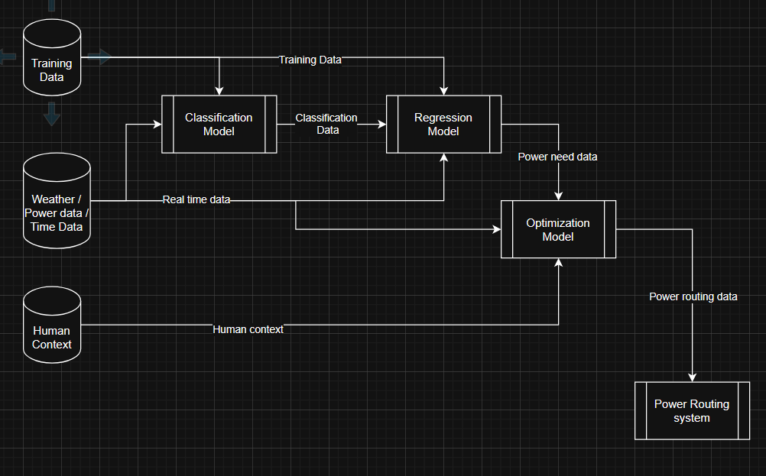
Part 2: System Data Architecture
SLIDE 3 OF 9
Data streams: Historical: all_users_energy.csv · Real-time: Live Sensors · Contextual: Human Input
3 / 9
Smart City AI Design Challenge · James Mitchell · May 2025

Slide 4
Part 3: Our AI Pipeline
SLIDE 4 OF 9
📈 REGRESSION
🏷️ CLASSIFICATION
⚡ OPTIMIZATION
What does it predict?
What does it decide?
What does it optimize?
kWh demand by hour for each building type. Based on hour of day, season, temperature, and day of week
What classification tier each building belongs to. Either Critical, Flexible, or Non-Critical, decided based on energy consumption trends.
Power distribution based on type of emergency and current real-world factors, along with human input.
R² = 0.958 | MAE = 25.8 kWh
Accuracy = 94.2% | Critical recall = 100%
Implements human input and real-world data
Week 2 teams: add your actual results
Week 2 teams: add your confusion matrix results
All teams: describe conceptually
4 / 9
Smart City AI Design Challenge · James Mitchell · May 2025

Slide 5
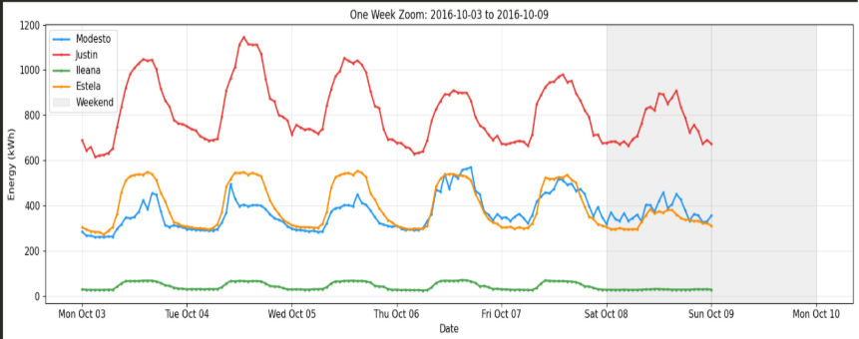
Part 4: Our Evidence — Visualization 1
SLIDE 5 OF 9
Question this answers: How does power usage vary over time on the daily scale?
[ PASTE YOUR VISUALIZATION HERE ]
What this tells us:
This diagram plots the power usage of each building at the hospital; it shows a large variance in power usage throughout the day and differences within different days of the week, meaning that it will be crucial to factor in day and time into our model.
5 / 9
Smart City AI Design Challenge · James Mitchell · May 2025

Slide 6
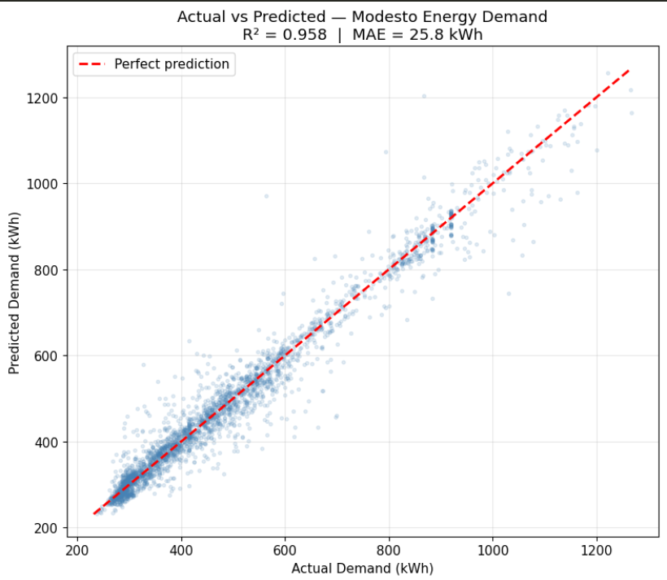
Part 4: Our Evidence — Visualization 2
WEEK 2: MODEL OUTPUT
SLIDE 6 OF 9
Question this answers: How accurate is our regression model in predicting the energy demand of the Modesto building?
[ PASTE MODEL OUTPUT
(actual vs predicted plot,
confusion matrix, etc.) ]
Key numbers:
Regression Model: R² = 0.958 MAE = 25.8 kWh
Classification Model: Critical accuracy = 100% Hardest to classify: Gas Station
6 / 9
Smart City AI Design Challenge · James Mitchell · May 2025

Slide 7
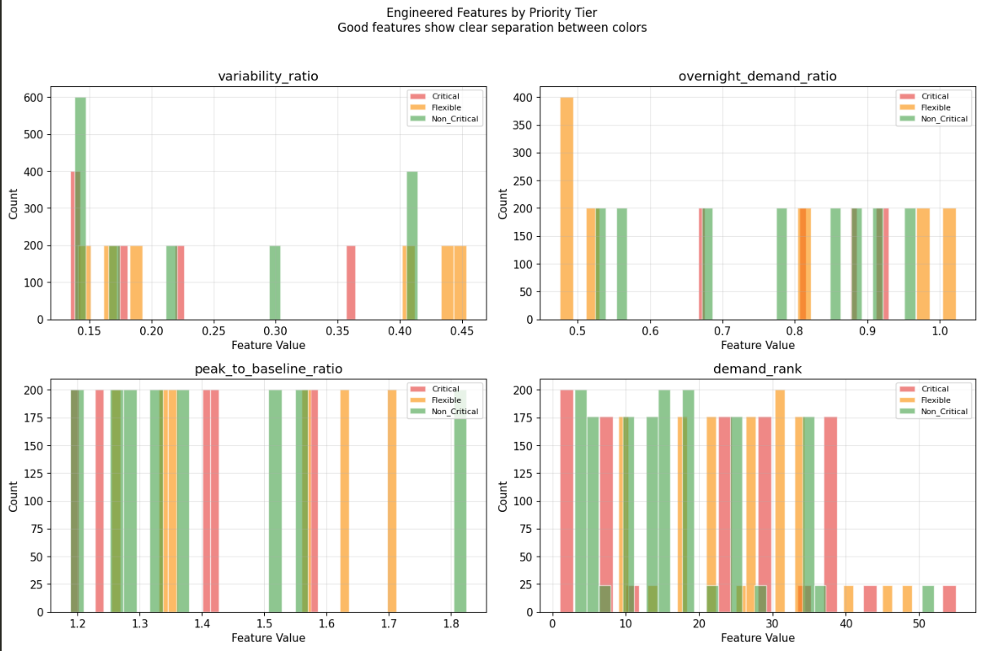
Part 4: Our Evidence — Visualization 3
WEEK 3: MODEL OUTPUT
SLIDE 7 OF 9
Question this answers: What correlation can be found in the classification of the buildings.
[ PASTE MODEL OUTPUT
(actual vs predicted plot,
confusion matrix, etc.) ]
What this shows:
At first sight there seems to be no correlation between individual features and a buildings' criticality ranking; this demonstrates why we used a decision tree model to classify buildings. Instead of trying to find a trend in the data, it divides data in a sort of binary search to determine its ranking.
7/ 9
Smart City AI Design Challenge · James Mitchell · May 2025

Slide 8
Part 5: Design Limitations
SLIDE 8 OF 9
✅ What works well
⚠️ Where it struggles
Our designs perform well in extreme temperature scenarios, during business hours, and rerouting power in an emergency. For example, in situations where the main power grid goes down, our system quickly switches to backup power to keep everything running.
When predicting energy for flexible buildings. In our model and selections, flexible buildings tend to be wildly spread out in all sorts of factors, primary energy consumption, and variability. These factors make it difficult for a model to create parameters that consistently identify them.
👥 Who might be harmed
🔭 What we'd build next
Standard citizens attempting to evacuate and get gas for backup generators along with first responders in need of gas for their emergency vehicles could all be harmed if local gas stations run out of fuel or lose power.
If we had three more months, we would first implement the third optimization model, taking real world and human made inputs and optimizing the power routing based on such, then we would implement more advanced machine learning techniques rather than linear regression for the regression model, potentially replacing it with a random forest model or neural network. We would then implement real world non-functional testing, meaning that the model would be running in a simulation taking real live inputs and outputting real data that is not used.
8 / 9
Smart City AI Design Challenge · James Mitchell · May 2025

Slide 9
Late People
Thank You
Smart City AI Design Challenge
19
3
2
100%
Building Types
Analyzed
Data Streams
Integrated
AI Models
Designed
Critical Tier
Accuracy
Questions? · tagtribble@gmail.com
James Mitchell· 05/22/26· Boone High School

